Slide 1
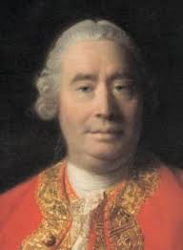
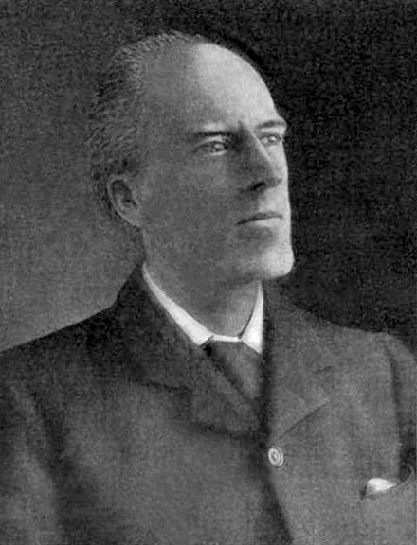
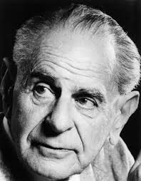
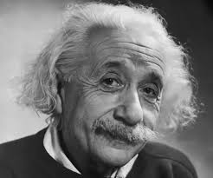
Causality
We call to mind the constant conjunction (of flame and heat) in all past instances. “Without any farther ceremony, we call the one cause and the other effect, and infer the existence of the one from that of the other.” David Hume 1739
“Beyond such discarded fundamentals as ‘matter’ and ‘force lies still another fetish amidst the inscrutable arcana of modern science, namely, the category of cause and effect.” ... “The ultimate scientific statement of description of the relation between two things can always be thrown back upon a contingency table.” Karl Pearson 1911
“The belief in causality is metaphysical. It is nothing but a typical metaphysical hypostatization of a well-justified methodological rule- the scientist's decision never to abandon his search for laws.” Karl Popper 1934
“Development of Western science is based on two great achievements: the invention of the formal logical system (in Euclidean geometry) by the Greek philosophers, and the discovery of the possibility to find out causal relationships by systematic experiment.” Albert Einstein 1953
1
Notes:
1
To keep the curious occupied until I start talking

Slide 2
Causality
Causality is an illusion arising from repeated temporal conjunction (Hume)
Causality is outdated, correlation is all that is required (Pearson)
Looking for causal laws seems to work (Popper)
Learning causal relationships is central to science and we do it via systematic experiment (Einstein)
A causal model is one that predicts the outcome of intervention in a system
2
Notes:
2
We will take a very pragmatic view – causality may be an illusion, along with free will. In some sense it is clear it is an artefact introduced by our failure to include the entire universe in our models. However, (at least under the assumption that we are capable of making decisions and manipulating the world – causal models make useful tools.
Any model that can predict the outcome of an intervention in a system is causal
A causal effect is the outcome of intervening in a system.

Slide 3
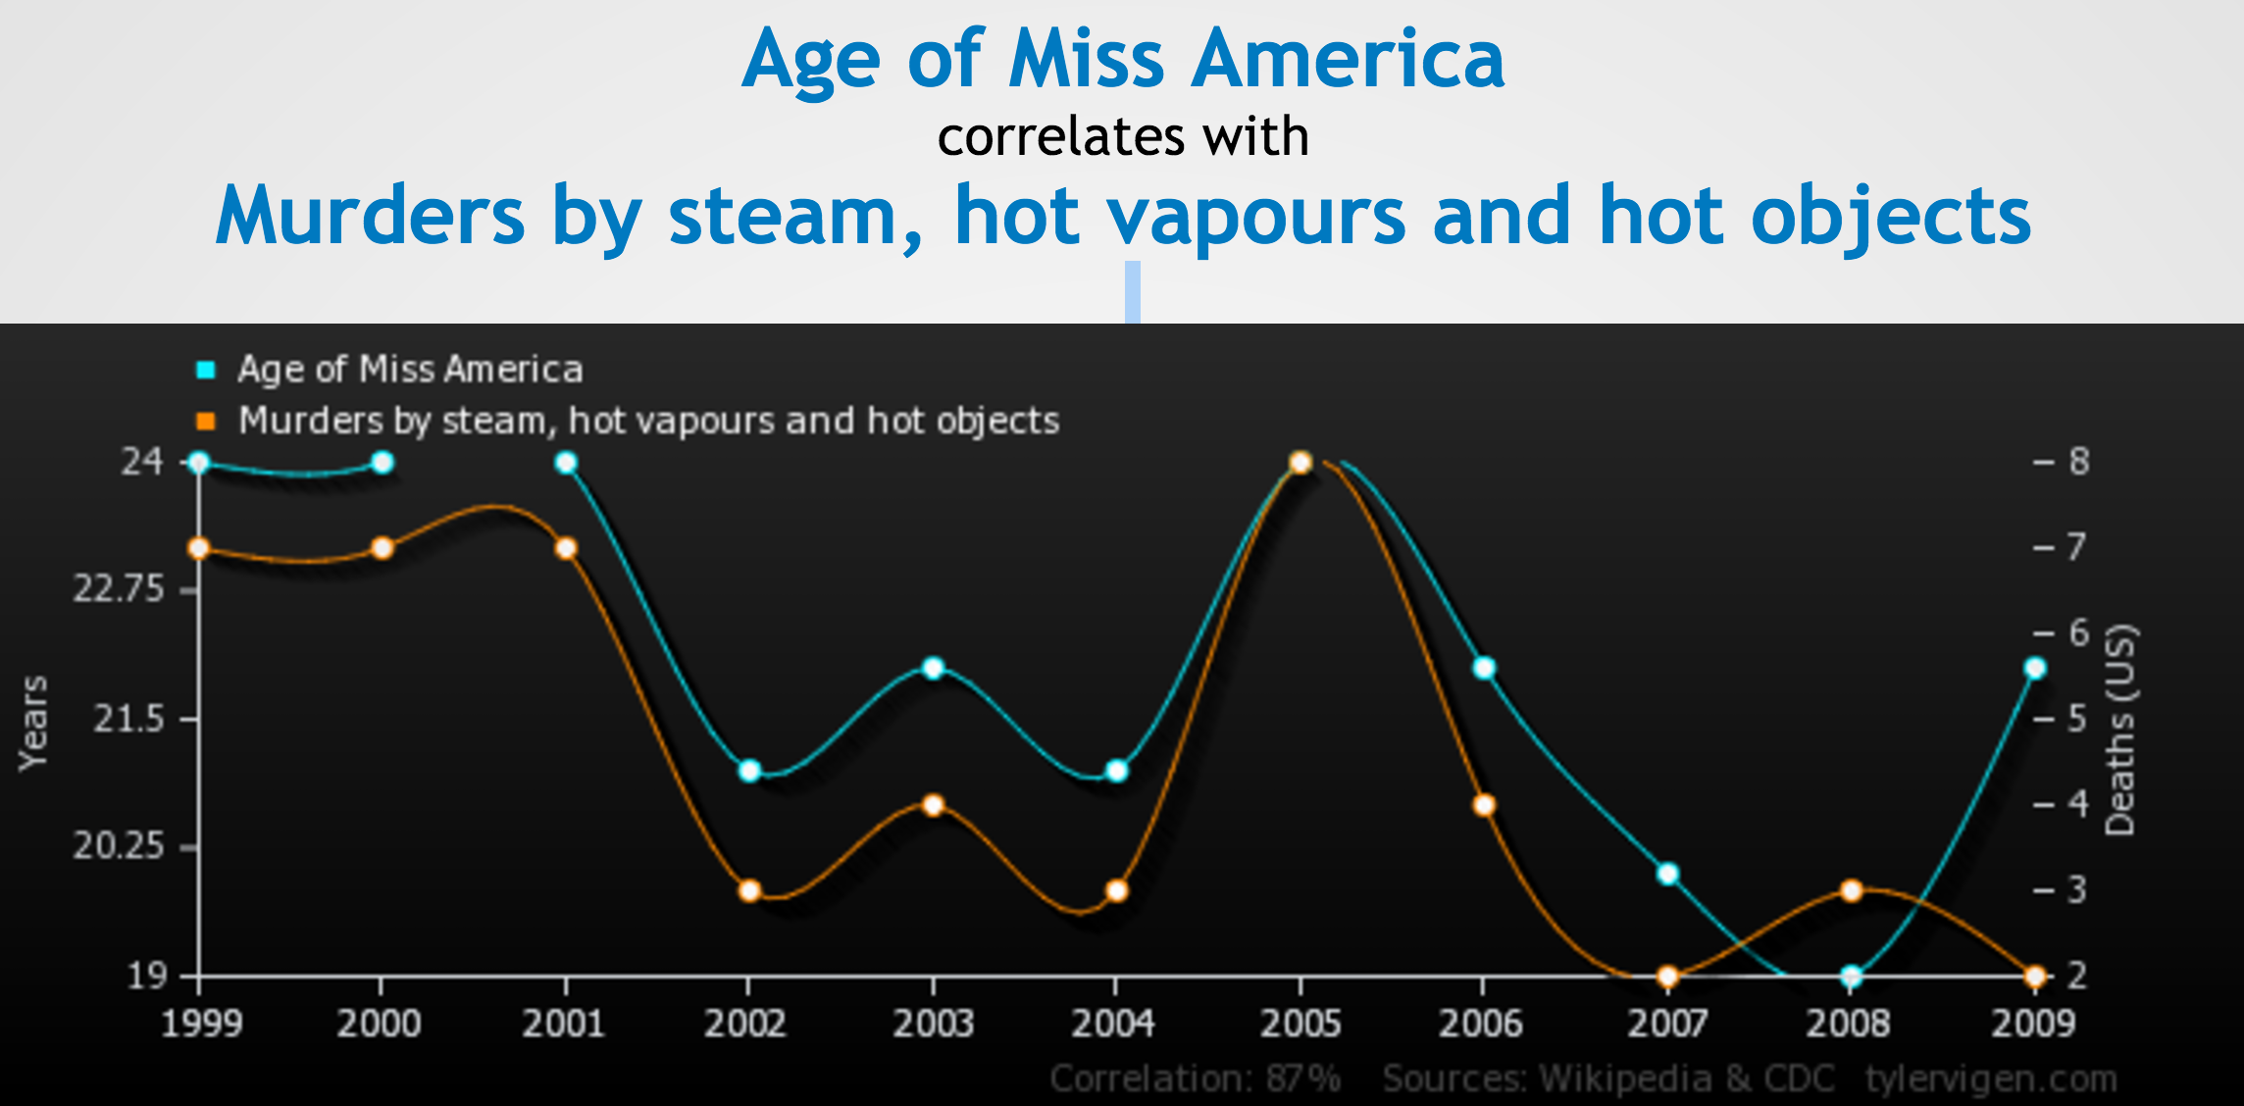
Correlation is not causation
Image source: www.tylervigen.com/
3
Notes:
3

Slide 4
When do we care about causality?
Forecasting the weather
Image classification
Predicting which patients are at risk of death from pneumonia
Predicting who will offend whilst on parole
The real question is “when don’t we care?”
4
Notes:
4

Slide 5
Overview – Causal inference in ML
What is causality?
Why should we care in machine learning?
Observational causal inference
Interventional causal inference
A unified approach - Causal Bandits
5
Notes:
5

Slide 6
Observational causal inference
6
Notes:
6

Slide 7
Causal Bayesian Networks
Truncated product formula: drop terms for intervened variables from the factorisation.
A CBN represents the set of all possible interventional distributions over its variables
7
Notes:
7
high light what remains invariant

Slide 8
The do calculus (simplified)
8
Notes:
8
Things are more interesting when there are latent variables
The do notation is just a notation – the question is can properties of one system be inferred from another.
Explain the localisation property of d-separation.
The do calculus is complete

Slide 9
Identifiability
9
Notes:
9
Things are more interesting when there are latent variables
The do notation is just a notation – the question is can properties of one system be inferred from another.
Explain the localisation property of d-separation.
The do calculus is complete

Slide 10
Inference from observational data – aka Pearl
10
Notes:
10

Slide 11
Pesky statistical issues
Training data
Test data
11
Notes:
11
TODO make labels larger

Slide 12
Can’t we just be Bayesian?
12
Notes:
12

Slide 13
Careful with that prior
The goal is to estimate the causal effect of X on Y
It is indefinable via the do-calculus
13
Notes:
13

Slide 14

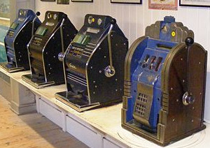
The interventional approach to causality
Randomized trials are the traditional gold standard for determining causality
Bandits?
14
Notes:
14
The key function of randomisation is to break the link with any confounders - the true key is explicit control of actions.
Bandits algorithms also explicitly assign actions and typically utilize randomization – but also account for the sequential nature of decision processes.

Slide 15
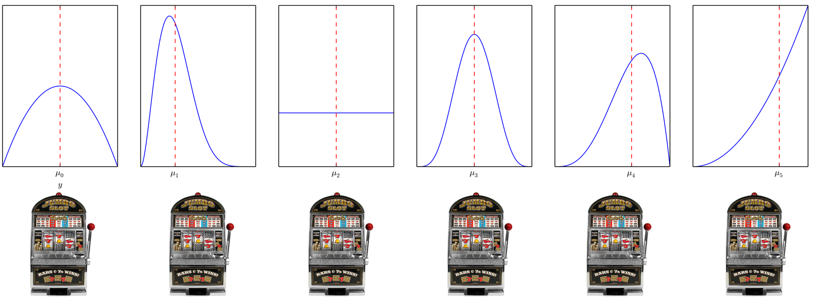
Classic Multi-armed Bandits
15
Notes:
15

Slide 16
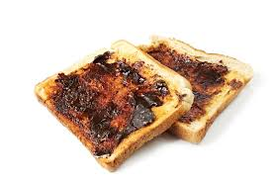
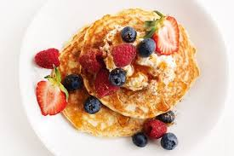
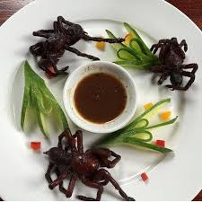
Key Challenges & Approaches
Explore-exploit trade-off
Non i.i.d data
Regret
16
Notes:
16
The goal is not to learn a good estimate for all actions – it is to play suboptimal actions as little as possible
Sublinear (in T) regret means we are learning – the longer the time the better on average our choices.
This is worst-case (or distribution independent regret)
Approaches
UCB (optimism in the face of uncertainty)
Sample from some weighted combination of the actions (Exp3 & Thompson sampling)
Eliminate sub-optimal actions
Bandits are RL with immediate feedback (or single state MDPs)
-
Contrast to uniform exploration (eg A/B test)
Optimal experimental design – (best arm identification is a form of this)

Slide 17



Contextual Bandits
17
Notes:
17
There are many variants of the bandit problem
Adversarial – instead of the environment generating rewards purely stochastically – think of it as an adversary, who knows your algorithm and can try to design the distribution of rewards to thwart you.
Contextual bandits – we can observe some characteristics of the individual before we select an action – the naïve solution (for discrete context) is to run an independent bandit algorithm for each possible value of context.
Off-policy evaluation

Slide 18
Causal structure of contextual bandit problems
Contextual bandit algorithms do not require that the context is a cause of the outcome.
18
Notes:
18

Slide 19
Why unify causal graphs and bandits?
Regret grows linearly with the number of actions
There is a lot of data available for which we do not control/know the process selecting actions
Bandits are a nice subset of general RL problems
19
Notes:
19
Regret increases linearly with the number of arms (problem dependent regret does) – this is bad when we have exponentially many actions to explore.
Do we really need another flavour of bandit?

Slide 20
Causal Bandit Problems
Every (allowable) assignment of variables to values is a bandit arm.
Reward is value of a single specified node in the graph after the action.
20
Notes:
20

Slide 21
How can causal structure be leveraged
Prune actions before commencing
Obtain information about the reward for one action by selecting another.
21
Notes:
21
If the goal is to reduce cancer – we do not have to consider any interventions involving asthma, or intervention on poverty if we already control smoking and diet.

Slide 22
C-Bandit problems with post-action feedback
Problems for which additional feedback available only after action selected (no context).
Focus is on the simple regret
22
Notes:
22
Simple regret arises in best-arm identification or pure-exploration problems – where we can explore without penalisation during some training period and must then identify an optimal arm. It arises in practise in settings in which we can simulate data – or where the overhead of a ‘experimental’ period is high – such that we want to identify the best option during a learning phase and then select that option from then on.
Best-arm identification still has an explore-exploit trade-off – we are still not trying to learn about the rewards of all arms (we only need to learn about plausibly optimal arms) but it’s a subtly different to the one for cumulative regret.

Slide 23
The parallel bandit problem
23
Notes:
23

Slide 24
The parallel bandit problem – algorithm
Observe for first T/2 rounds to estimate reward for actions that occur frequently naturally.
Uniformly explore infrequent actions in remaining rounds.
But how do we define infrequent?
24
Notes:
24
There are m(q) infrequent arms, so T/2m samples for them. The remaining arms also get ~T/2m samples because they occur with probability > 1/m(q) during observe phase.
These definition for m assumes we do some relabelling such that the q_i’s are <= .5 and ordered – does not effect generality.
We do not assume m(q) is known – estimate this from the first T/2 rounds

Slide 25
The parallel bandit problem – regret bounds
Parallel bandit
Standard bandit
25
Notes:
25
See that the approach is order optimal (worst case).

Slide 26
General graphs - challenges
We could map from observation to intervention via the do-calculus but,
Its no longer optimal ignore the information intervening on one variable can provide about another.
26
Notes:
26

Slide 27
General graphs - challenges
27
Notes:
27
The point is that P(X_2 = 1) = 0.5

Slide 28
General graphs - solution
28
Notes:
28
This is a strong assumption – but there are cases in which it is realistic, ie a company may be able to control a range of levers and know how each of these levers impact a number of characteristics of their business – but not how some external quantity might respond.

Slide 29
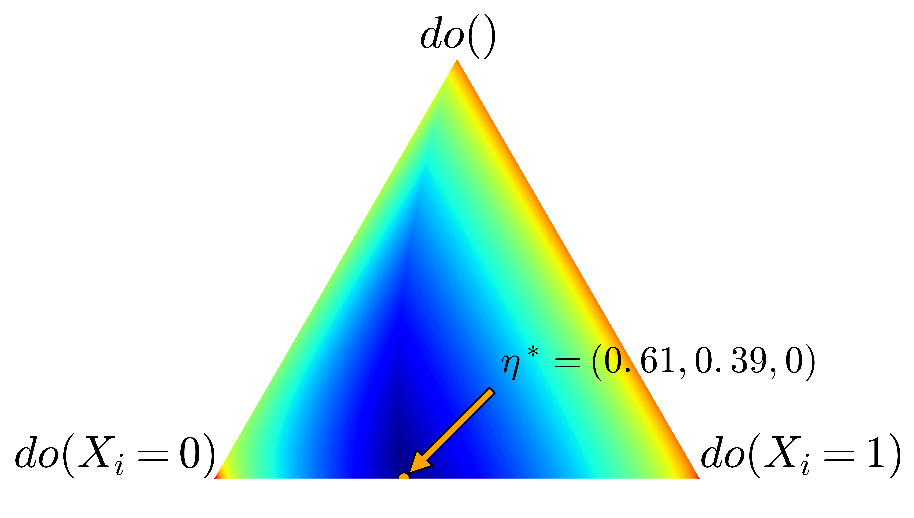
General graphs - solution
29
Notes:
29
m(eta*) is the minimum worst-case variance of the importance weighted estimator – also an effective number of arms.
m(eta*) is 3.8 in this setting.

Slide 30
General graphs - solution
General CB upper bound
Standard lower bound
30
Notes:
30
m(eta*) is the minimum worst-case variance of the importance weighted estimator – also an effective number of arms.

Slide 31
Experiments
31
Notes:
31
m(eta*) is the minimum worst-case variance of the importance weighted estimator – also an effective number of arms.

Slide 32
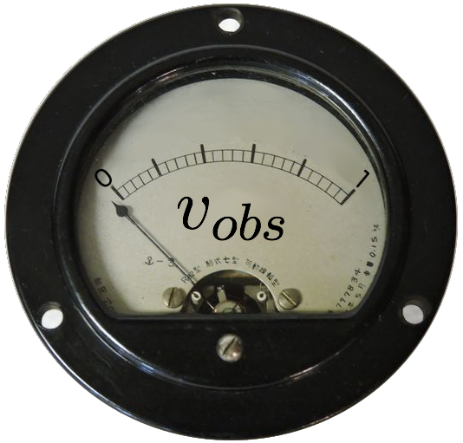
Quantifying the value of intervention
32
Notes:
32

Slide 33
Summary & Future Work
Bandits and causal inference fundamentally solve the same problem – learning to act
Adding structure to bandit problems with causal graphical models allows us to explore large action spaces much more quickly
Many open questions: relaxing the assumption that the interventional distributions are known, contextual causal bandit problems, cumulative regret, extensions to MDPs, connections between causal effect estimation and off-policy evaluation
33
Notes:
33
The optimism principle breaks when we have information sharing across arms.
There is a general principle that could be applied to minimize Bayesian regret – Information direct sampling
Its important to put these two parts together because, from a bandit perspective, structure is needed to make learning how to act feasible in realistic problems with many potential variables to control – and potentially exponentially many actions - and from a observational causal inference perspective because not everything can be learnt from observational data.
Could we use the corelling bandit approach – such that if the assumption is wrong we switch to using the better estimation method?

Slide 34
Questions
?
34
Notes:
34

Slide 35
Counterfactuals & Structural equation models
35
Notes:
35

Slide 36
A map of the literature
36
Notes:
36

Slide 37
Simpson’s Paradox
37
Notes:
37

